Slide 1
Optimal algorithms for experts and mixtures of Gaussians
Version of August 4, 2020
Chris Liaw
UBC, August 2020

Slide 2
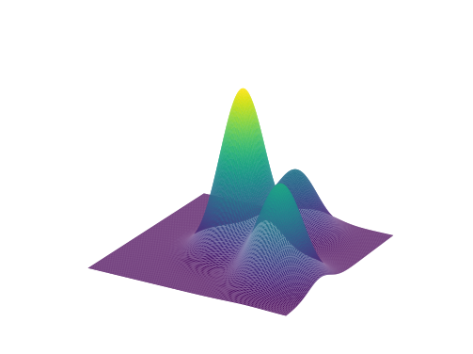
Research overview
Goal: Design & analyze machine learning algorithms with provable guarantees.
Prediction with expert advice
[HLPR, FOCS‘20]
Learning mixtures of Gaussians
[ABHLMP NeurIPS’18, JACM’20]
Notes:
Do I want to mention other stuff that I have worked on? E.g. the neural net stuff or the SGD stuff?
Research goal is to design and analyze machine learning algorithms that have provable guarantees.
Today, give a taste of some of the work that I have been most proud of: prediction with expert advice and learning mixtures of Gaussians.

Slide 3
Part 1. Optimal anytime regret with two experts.
Nicholas J. A. Harvey, Christopher Liaw, Edwin Perkins, Sikander Randhawa. Optimal Anytime Regret with Two Experts. FOCS 2020.

Slide 4
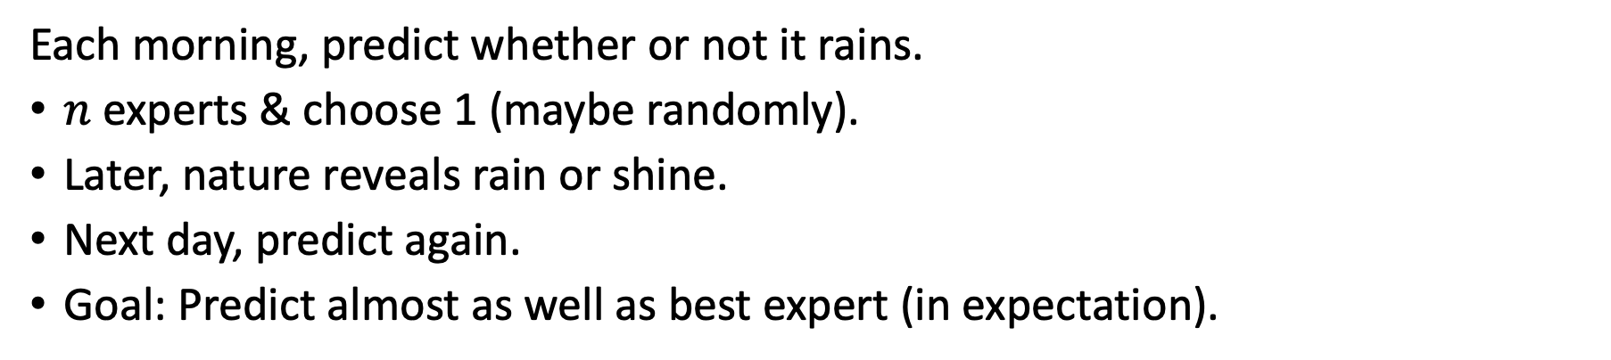
Prediction with expert advice
Each morning, predict whether or not it rains.
$n$ experts & choose 1 (maybe randomly).
Later, nature reveals rain or shine.
Next day, predict again.
Goal: Predict almost as well as best expert (in expectation).

Slide 5
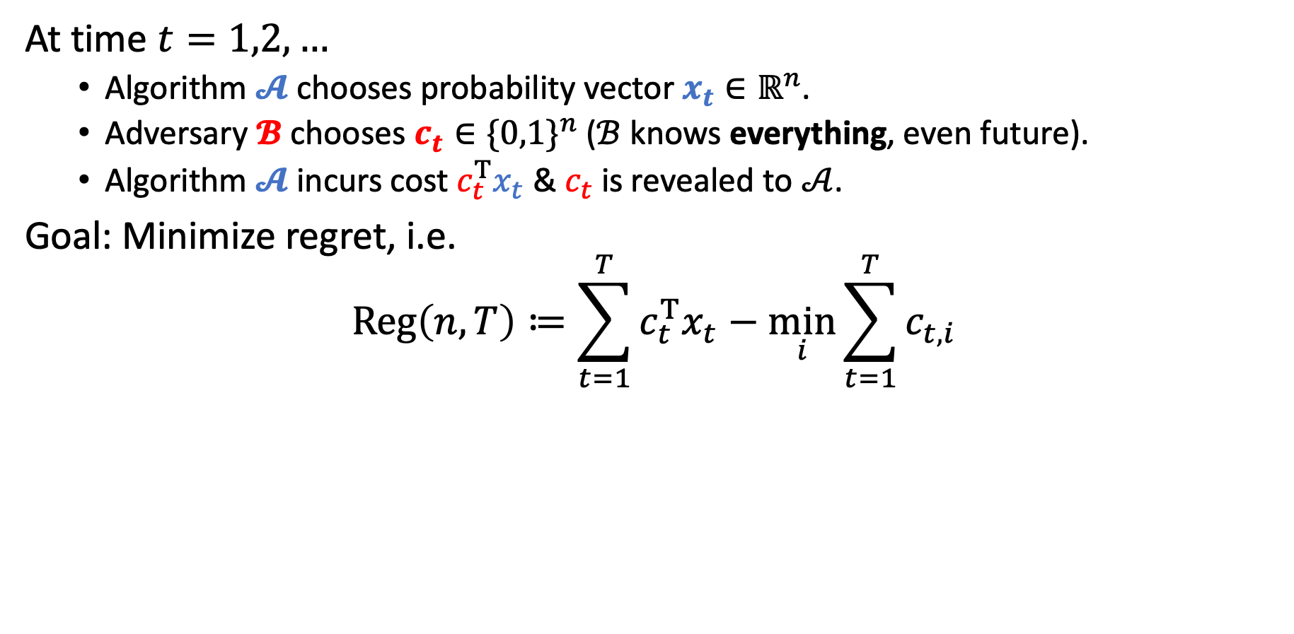
Prediction with expert advice
At time $t=1,2,…$
Algorithm $𝓐$ chooses probability vector $x_{t}∈ℝ^{n}$.
Adversary $𝓑$ chooses $c_{t}∈{\{0,1\}}^{n}$ ($ℬ$ knows everything, even future).
Algorithm $𝓐$ incurs cost $c_{t}^{T}x_{t}$ & $c_{t}$ is revealed to $𝒜$.
Goal: Minimize regret, i.e.
$$Reg\left(n,T\right)≔\sum_{t=1}^{T}{c_{t}^{T}x_{t}}−\min_{i}{\sum_{t=1}^{T}{c_{t,i}}}$$
Algorithm’s cost
Cost of best expert
Note. There is no randomness in the problem.

Slide 6

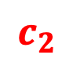
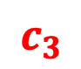
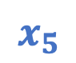
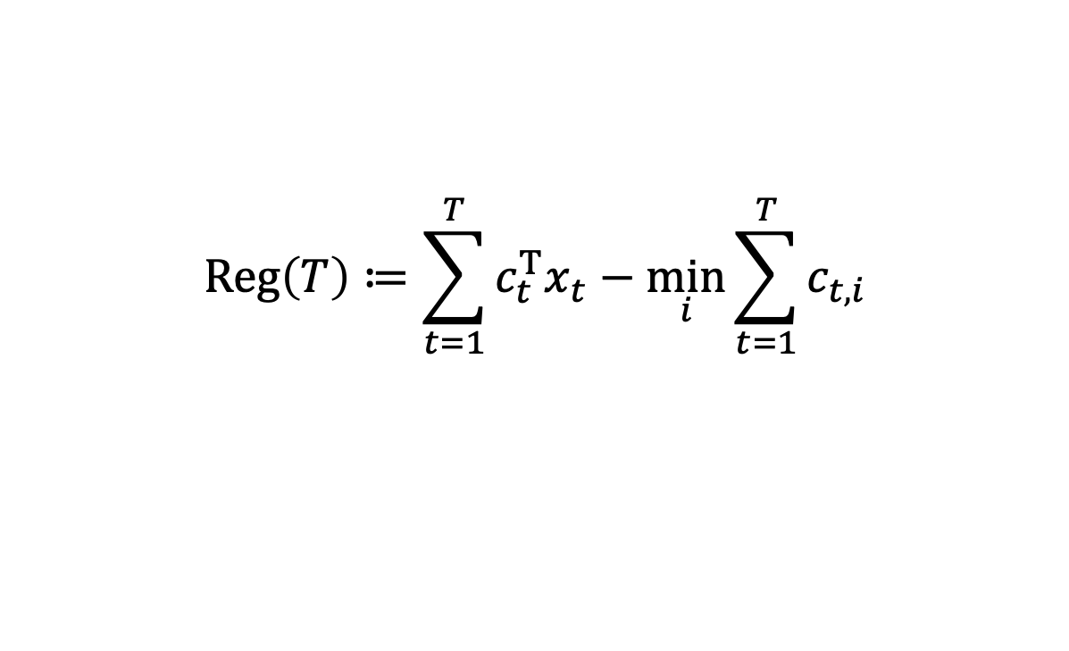
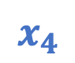
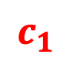


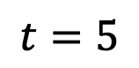
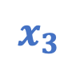
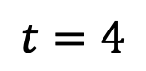

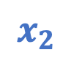
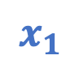
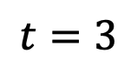
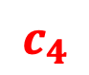
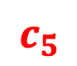
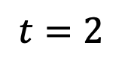

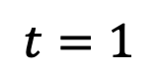


Example
$$Reg\left(T\right)≔\sum_{t=1}^{T}{c_{t}^{T}x_{t}}−\min_{i}{\sum_{t=1}^{T}{c_{t,i}}}$$
Follow best expert?
$$t=1$$
$$t=2$$
$$t=3$$
$$t=4$$
$$t=5$$
$$x_{1}$$
$$c_{1}$$
$$x_{2}$$
$$c_{2}$$
$$x_{3}$$
$$c_{3}$$
$$x_{4}$$
$$c_{4}$$
$$x_{5}$$
$$c_{5}$$
0.5
$$1$$
0.0
$$0$$
0.5
$$0$$
1.0
$$1$$
0.5
$$1$$
0.5
$$0$$
1.0
$$1$$
0.5
$$1$$
0.0
$$0$$
0.5
$$0$$
Algorithm
0.5
1.5
2
3
3.5
Best Expert
0
1
1
2
2
Regret
0.5
0.5
1.0
1.0
1.5
Notes:
Wasting time

Slide 7
Example
$$Reg\left(T\right)≔\sum_{t=1}^{T}{c_{t}^{T}x_{t}}−\min_{i}{\sum_{t=1}^{T}{c_{t,i}}}$$
Follow best expert?
$$t=1$$
$$t=2$$
$$t=3$$
$$t=4$$
$$t=5$$
$$x_{1}$$
$$c_{1}$$
$$x_{2}$$
$$c_{2}$$
$$x_{3}$$
$$c_{3}$$
$$x_{4}$$
$$c_{4}$$
$$x_{5}$$
$$c_{5}$$
0.5
$$1$$
0.0
$$0$$
0.5
$$0$$
1.0
$$1$$
0.5
$$1$$
0.5
$$0$$
1.0
$$1$$
0.5
$$1$$
0.0
$$0$$
0.5
$$0$$
Following best expert can make regret grow linearly!
Algorithm
0.5
1.5
2
3
3.5
Best Expert
0
1
1
2
2
Regret
0.5
0.5
1.0
1.0
1.5
Notes:
Wasting time

Slide 8
Example
$$Reg\left(T\right)≔\sum_{t=1}^{T}{c_{t}^{T}x_{t}}−\min_{i}{\sum_{t=1}^{T}{c_{t,i}}}$$
A little hedging…
$$t=1$$
$$t=2$$
$$t=3$$
$$t=4$$
$$t=5$$
$$x_{1}$$
$$c_{1}$$
$$x_{2}$$
$$c_{2}$$
$$x_{3}$$
$$c_{3}$$
$$x_{4}$$
$$c_{4}$$
$$x_{5}$$
$$c_{5}$$
0.5
$$1$$
0.4
$$0$$
0.5
$$0$$
0.6
$$1$$
0.5
$$1$$
0.5
$$0$$
0.6
$$1$$
0.5
$$1$$
0.4
$$0$$
0.5
$$0$$
Algorithm
0.5
1.1
1.6
2.2
2.7
Best Expert
0
1
1
2
2
Regret
0.5
0.1
0.6
0.2
0.7
Notes:
Wasting time

Slide 9
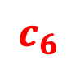
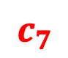

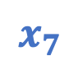
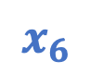
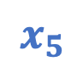
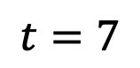
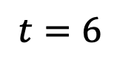
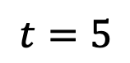
Example
$$Reg\left(T\right)≔\sum_{t=1}^{T}{c_{t}^{T}x_{t}}−\min_{i}{\sum_{t=1}^{T}{c_{t,i}}}$$
A little hedging…
$$t=5$$
$$t=6$$
$$t=7$$
$$x_{5}$$
$$c_{5}$$
$$x_{6}$$
$$c_{6}$$
$$x_{7}$$
$$c_{7}$$
0.5
$$1$$
0.4
$$1$$
0.4
$$0$$
0.5
$$0$$
0.6
$$1$$
0.6
$$0$$
Algorithm
2.7
3.7
3.7
Best Expert
2
3
3
Regret
0.7
0.7
0.7
Notes:
Wasting time

Slide 10
An abridged history
Problem dates back to 1950s; studied in Bayesian settings [Hannan, Robbins ‘55; Blackwell ICM‘54, ‘56; Hannan ‘57, etc.]
Multiplicative weights update algorithm [Littlestone, Warmuth ‘94; Vovk ‘91; DeSantis, Markowsky, Wegman ‘88; Cesa-Bianchi et al. ‘97]
Applications
Finance (universal portfolio) [Cover ‘91; Blum, Kalai ‘99; Kalai, Vempala ‘02]
Game theory (two player zero-sum games) [Blackwell ‘56; Hannan ‘57; Foster, Vohra ‘99; Freund, Schapire ‘99]
Information theory & coding theory [Cover ‘65, ‘74; Feder ‘91; Feder, Merhav, Gutman ‘92]
Notes:
Blackwell was looking at generalizations of von Neumann’s minimax for vector-valued playoffs.
Hannan was looking at the two-player zero-sum games.
DeSantis actually had something that looked like MWU in their paper
Universal portfolio: aim to do as well as the single best stock in your portfolio

Slide 11
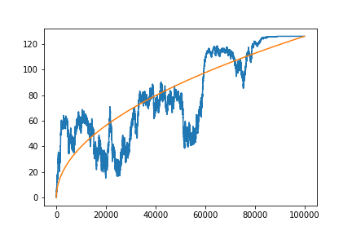
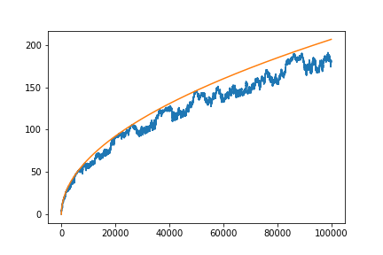

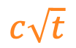

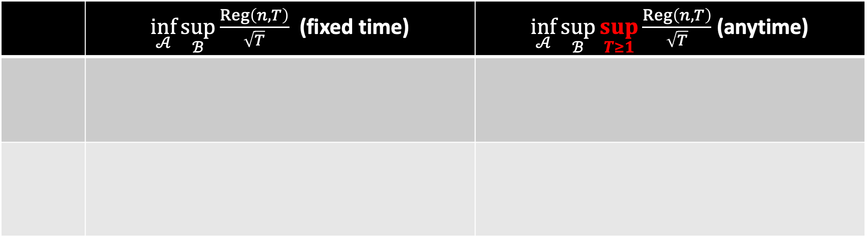
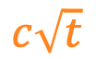
Known results
 | $\inf_{𝒜}{\sup_{ℬ}{\frac{Reg\left(n,T\right)}{\sqrt{T}}}}$ (fixed time) | $\inf_{𝒜}{\sup_{ℬ}{\sup_{T≥1}{\frac{Reg\left(n,T\right)}{\sqrt{T}}}}}$ (anytime)
$$c\sqrt{t}$$
$$c\sqrt{t}$$
$$Reg\left(t\right)$$
$$Reg\left(t\right)$$
Notes:
Split it up into upper and lower bound.

Slide 12
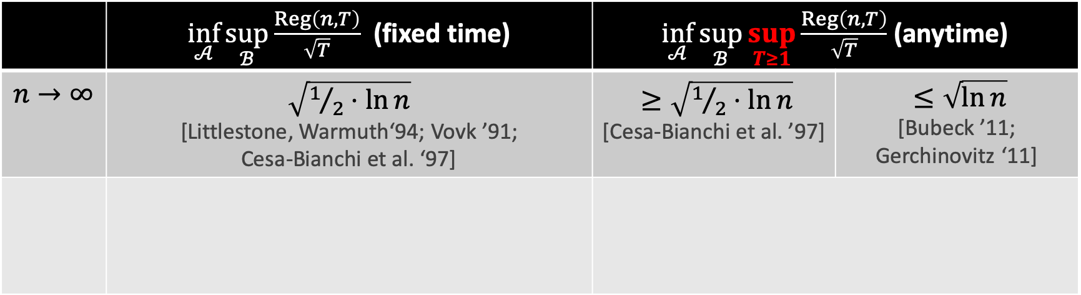
Known results
 | $\inf_{𝒜}{\sup_{ℬ}{\frac{Reg\left(n,T\right)}{\sqrt{T}}}}$ (fixed time) | $\inf_{𝒜}{\sup_{ℬ}{\sup_{T≥1}{\frac{Reg\left(n,T\right)}{\sqrt{T}}}}}$ (anytime)
$$n→∞$$ | $\sqrt{1/2⋅ln{n}}$ [Littlestone, Warmuth‘94; Vovk ’91; Cesa-Bianchi et al. ‘97] | $≥\sqrt{1/2⋅\ln{n}}$ [Cesa-Bianchi et al. ’97] | $≤\sqrt{\ln{n}}$ [Bubeck ’11; Gerchinovitz ‘11]
$$c\sqrt{t}$$
$$c\sqrt{t}$$
$$Reg\left(t\right)$$
$$Reg\left(t\right)$$

Slide 13
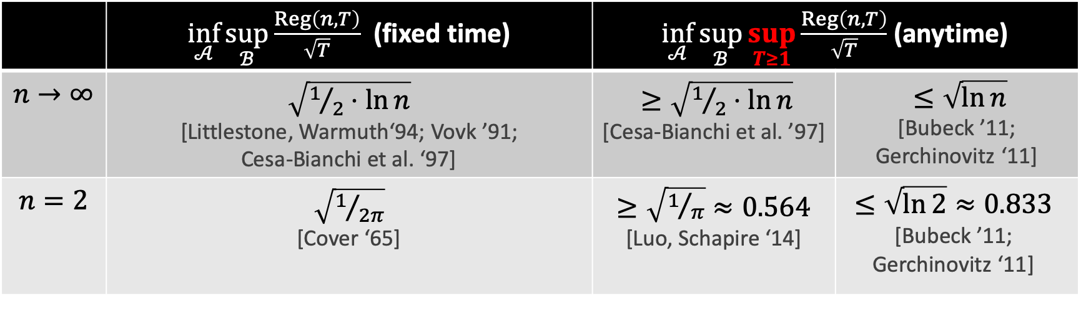
Known results
 | $\inf_{𝒜}{\sup_{ℬ}{\frac{Reg\left(n,T\right)}{\sqrt{T}}}}$ (fixed time) | $\inf_{𝒜}{\sup_{ℬ}{\sup_{T≥1}{\frac{Reg\left(n,T\right)}{\sqrt{T}}}}}$ (anytime)
$$n→∞$$ | $\sqrt{1/2⋅ln{n}}$ [Littlestone, Warmuth‘94; Vovk ’91; Cesa-Bianchi et al. ‘97] | $≥\sqrt{1/2⋅\ln{n}}$ [Cesa-Bianchi et al. ’97] | $≤\sqrt{\ln{n}}$ [Bubeck ’11; Gerchinovitz ‘11]
$$n=2$$ | $\sqrt{1/{2π}}$ [Cover ‘65] | $≥\sqrt{1/π}≈0.564$ [Luo, Schapire ‘14] | $$≤\sqrt{\ln{2}}≈0.833$$ [Bubeck ’11; Gerchinovitz ‘11]
$$c\sqrt{t}$$
$$c\sqrt{t}$$
$$Reg\left(t\right)$$
$$Reg\left(t\right)$$

Slide 14
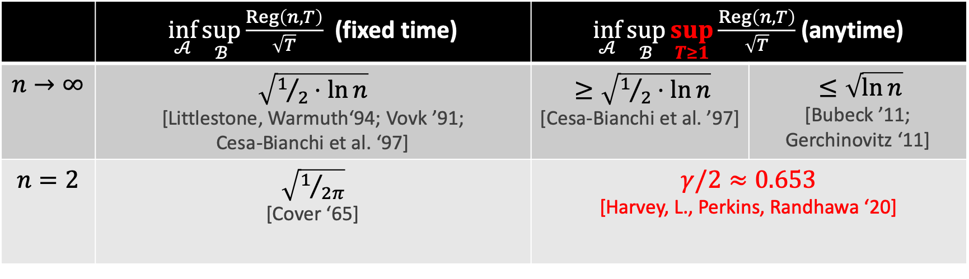
Known results
 | $\inf_{𝒜}{\sup_{ℬ}{\frac{Reg\left(n,T\right)}{\sqrt{T}}}}$ (fixed time) | $\inf_{𝒜}{\sup_{ℬ}{\sup_{T≥1}{\frac{Reg\left(n,T\right)}{\sqrt{T}}}}}$ (anytime)
$$n→∞$$ | $\sqrt{1/2⋅ln{n}}$ [Littlestone, Warmuth‘94; Vovk ’91; Cesa-Bianchi et al. ‘97] | $≥\sqrt{1/2⋅\ln{n}}$ [Cesa-Bianchi et al. ’97] | $≤\sqrt{\ln{n}}$ [Bubeck ’11; Gerchinovitz ‘11]
$$n=2$$ | $\sqrt{1/{2π}}$ [Cover ‘65] | $γ/2≈0.653$ [Harvey, L., Perkins, Randhawa ‘20]
$$c\sqrt{t}$$
$$c\sqrt{t}$$
$$Reg\left(t\right)$$
$$Reg\left(t\right)$$
Notes:
Maybe you can hint towards the big picture on slide 14 too: the goal is not really to say that 0.65 is better than 0.83, the goal is to understand the fundamental ideas that underlie the optimal numbers. With Cover, the optimal number comes from properties of random walks of length T. With us, the optimal number also comes from random walks / Brownian motion, but uncovering that number is a bit more complicated because you have to solve a stochastic calculus problem.

Slide 15
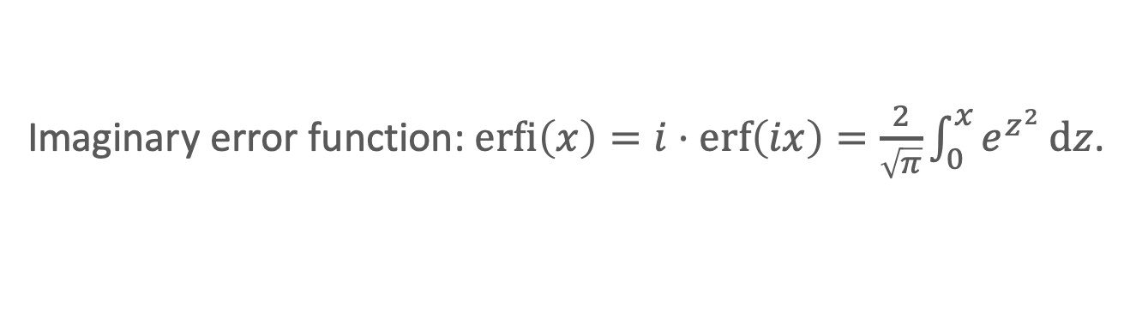
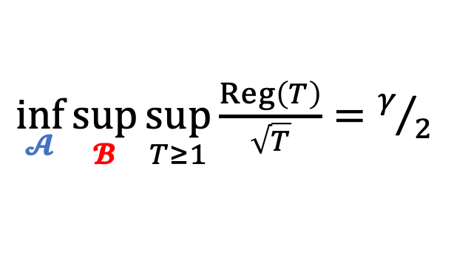
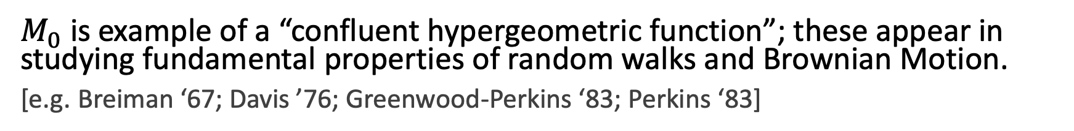
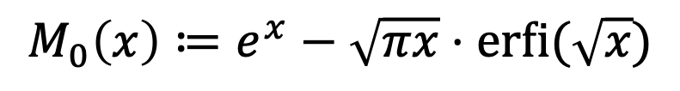
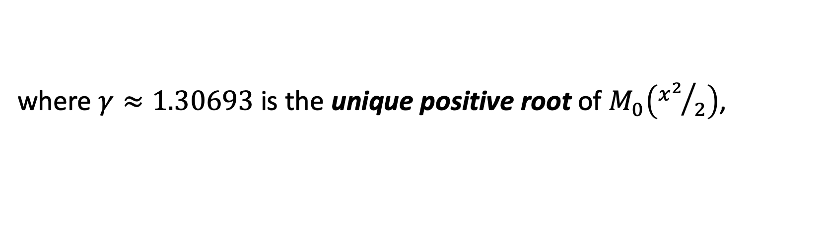
Our result
Imaginary error function: $\operatorname{erfi}\left(x\right)=i⋅erf\left(ix\right)=\frac{2}{\sqrt{π}}\int_{0}^{x}{e^{z^{2}}}dz$.
Theorem [HLPR ‘20]
For $n=2$ experts:
$\inf_{𝓐}{\sup_{𝓑}{\sup_{T≥1}{\frac{Reg\left(T\right)}{\sqrt{T}}}}}=γ/2$
where $γ≈1.30693$ is the unique positive root of $M_{0}\left({x^{2}}/2\right)$,
$$M_{0}\left(x\right)≔e^{x}−\sqrt{πx}⋅\operatorname{erfi}{(\sqrt{x}})$$
$M_{0}$ is example of a “confluent hypergeometric function”; these appear in studying fundamental properties of random walks and Brownian Motion.
[e.g. Breiman ‘67; Davis ’76; Greenwood-Perkins ‘83; Perkins ‘83]
Today: we focus on the algorithm; its design involves stochastic calculus, PDEs, & confluent hypergeometric functions.

Slide 16
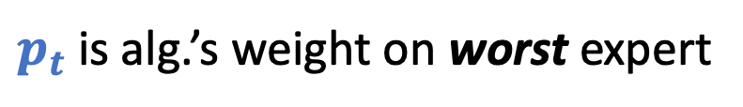
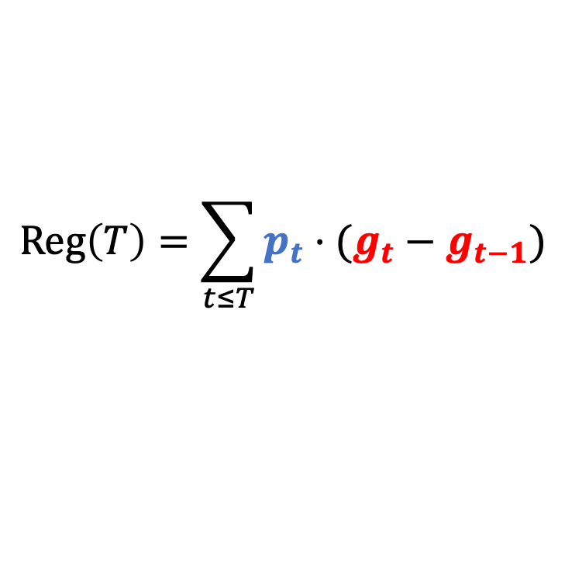
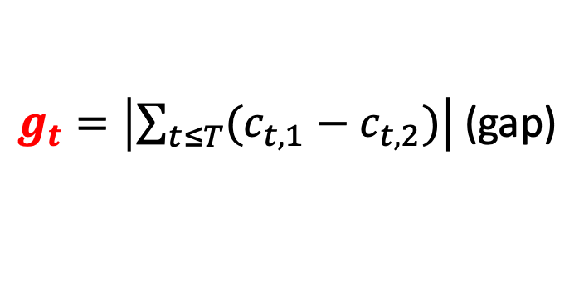
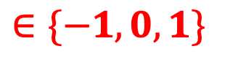
Regret for 2 experts
Simple expression for regret with 2 experts:
$$Reg\left(T\right)=\sum_{t≤T}{p_{t}⋅(g_{t}−g_{t−1})}$$
$g_{t}=\left|\sum_{t≤T}{(c_{t,1}−c_{t,2})}\right|$ (gap)
$p_{t}$ is alg.’s weight on worst expert
$$∈\{−1,0,1\}$$
Best expert gets cost 1.
Worst expert gets cost 1.
Equal costs on experts.

Slide 17
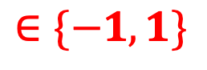
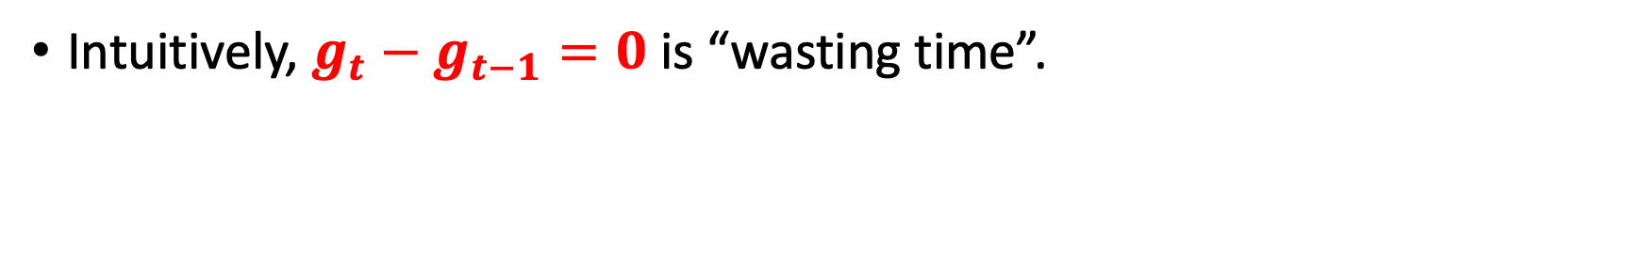
Regret for 2 experts
Simple expression for regret with 2 experts:
$$Reg\left(T\right)=\sum_{t≤T}{p_{t}⋅(g_{t}−g_{t−1})}$$
$g_{t}=\left|\sum_{t≤T}{(c_{t,1}−c_{t,2})}\right|$ (gap)
$p_{t}$ is alg.’s weight on worst expert
$$∈\{−1,1\}$$
Intuitively, $g_{t}−g_{t−1}=0$ is “wasting time”.

Slide 18
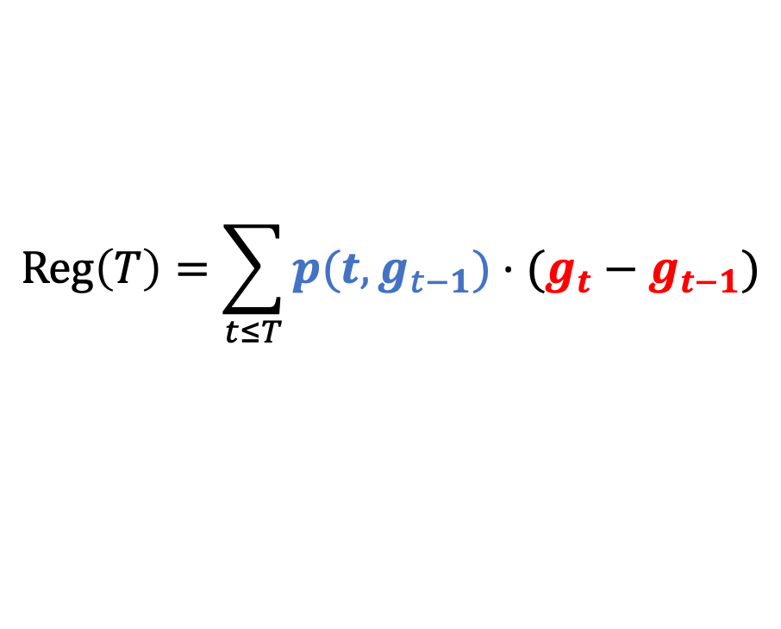
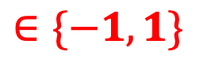
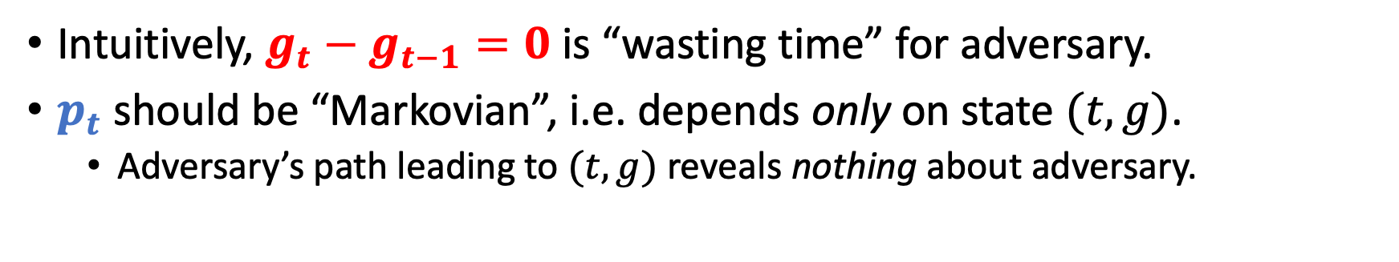
Regret for 2 experts
Simple expression for regret with 2 experts:
$$Reg\left(T\right)=\sum_{t≤T}{p(t,g_{t−1})⋅(g_{t}−g_{t−1})}$$
$g_{t}=\left|\sum_{t≤T}{(c_{t,1}−c_{t,2})}\right|$ (gap)
$p_{t}$ is alg.’s weight on worst expert
$$∈\{−1,1\}$$
Intuitively, $g_{t}−g_{t−1}=0$ is “wasting time” for adversary.
$p_{t}$ should be “Markovian”, i.e. depends only on state $(t,g)$.
Adversary’s path leading to $(t,g)$ reveals nothing about adversary.

Slide 19
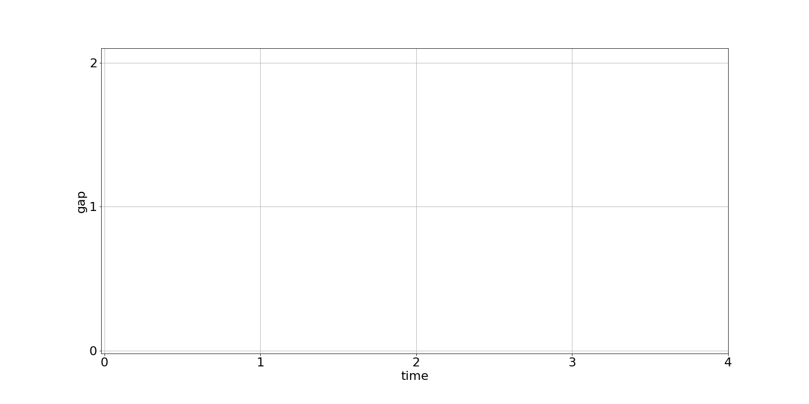








Regret for 2 experts
$$Reg\left(T\right)=\sum_{t≤T}{p(t,g_{t−1})⋅(g_{t}−g_{t−1})}$$
$$Reg\left(1\right)=0.5$$
$$p\left(2,1\right)=0.4$$
$$Reg\left(3\right)=0.6$$
$$Reg\left(0\right)=0$$
$$p\left(1,0\right)=0.5$$
$$Reg\left(2\right)=0.1$$
$$p\left(3,0\right)=0.5$$

Slide 20






Regret for 2 experts
$$Reg\left(T\right)=\sum_{t≤T}{p(t,g_{t−1})⋅(g_{t}−g_{t−1})}$$
$$Reg\left(2\right)=0.9$$
$$p\left(3,2\right)=0.25$$
$$Reg\left(1\right)=0.5$$
$$p\left(2,1\right)=0.4$$
$$Reg\left(3\right)=0.65$$
$$Reg\left(3\right)=0.6$$
$$Reg\left(0\right)=0$$
$$p\left(1,0\right)=0.5$$
$$Reg\left(2\right)=0.1$$
$$p\left(3,0\right)=0.5$$

Slide 21


Regret for 2 experts
Regret is inherently a path-wise quantity.
Can we design $p(t,g)$so regret is path-independent?
Can continuous viewpoint provide us more tools?
$$Reg\left(T\right)=5.6$$
$$Reg\left(T\right)=5.8$$
$$Reg\left(T\right)=6.1$$

Slide 22




Regret as a stochastic integral
Discrete regret for two experts.
Continuous regret for two experts.
$$Reg\left(T\right)=\sum_{t≤T}{p(t,g_{t−1})⋅(g_{t}−g_{t−1})}$$
$$ContReg\left(T\right)=\int_{0}^{T}{p\left(t,\left|B_{t}\right|\right) d\left|B_{t}\right| }$$
Idea. View $g_{t}$ as reflected random walk. Goal. Control $Reg\left(T\right)$ a.s.
$B_{t}$ is a Brownian Motion.
Goal. Control $ContReg\left(T\right)$ a.s.
Alg/Adv play at discrete times.
Alg/Adv play continuously.

Slide 23




Itô and the Backwards Heat Equation
$ContReg\left(T\right)=\int_{0}^{T}{p\left(t,\left|B_{t}\right|\right) d\left|B_{t}\right| }$
Itô’s Lemma
(define)
Kiyoshi Itô
$R\left(T,\left|B_{T}\right|\right)=\int_{0}^{T}{∂_{x}R\left(t,\left|B_{t}\right|\right) d\left|B_{t}\right| }+\int_{0}^{T}{\left(∂_{t}+1/2∂_{xx}\right)R\left(t,\left|B_{t}\right|\right) dt}$
Assuming $R\left(0,0\right)=0.$
$$ContReg\left(T\right)≠ContReg\left(T\right)≠ContReg(T)$$

Slide 24
Itô and the Backwards Heat Equation
$ContReg\left(T\right)=\int_{0}^{T}{p\left(t,\left|B_{t}\right|\right) d\left|B_{t}\right| }$
Itô’s Lemma
(define)
Kiyoshi Itô
$R\left(T,\left|B_{T}\right|\right)=\int_{0}^{T}{∂_{x}R\left(t,\left|B_{t}\right|\right) d\left|B_{t}\right| }+\int_{0}^{T}{\left(∂_{t}+1/2∂_{xx}\right)R\left(t,\left|B_{t}\right|\right) dt}$
Path independent.
Path dependent.
$$ContReg\left(T\right)≠ContReg\left(T\right)≠ContReg(T)$$

Slide 25

Itô and the Backwards Heat Equation
$ContReg\left(T\right)=\int_{0}^{T}{p\left(t,\left|B_{t}\right|\right) d\left|B_{t}\right| }$
Itô’s Lemma
(define)
Kiyoshi Itô
$R\left(T,\left|B_{T}\right|\right)=\int_{0}^{T}{∂_{x}R\left(t,\left|B_{t}\right|\right) d\left|B_{t}\right| }+\int_{0}^{T}{\left(∂_{t}+1/2∂_{xx}\right)R\left(t,\left|B_{t}\right|\right) dt}$
Path independent.
$=0$ (BHE)
$$ContReg\left(T\right)=ContReg\left(T\right)=ContReg(T)$$

Slide 26





Itô and the Backwards Heat Equation
$ContReg\left(T\right)=\int_{0}^{T}{p\left(t,\left|B_{t}\right|\right) d\left|B_{t}\right| }$
$R\left(T,\left|B_{T}\right|\right)=\int_{0}^{T}{∂_{x}R\left(t,\left|B_{t}\right|\right) d\left|B_{t}\right| }=ContReg\left(T\right)$
Algorithm
Kiyoshi Itô
(Assuming $\left(∂_{t}+1/2∂_{xx}\right)R=0$.)
Solving BHE gives $R(t,x)$ satisfying $R\left(t,x\right)≤γ\sqrt{t}/2$.
Miracle. This can all be discretized (discrete Itô, discrete BHE, etc.).
$$∂_{x}R\left(t,γ\sqrt{t}\right)=0$$
(no mass on very
bad expert)
$$ContReg\left(T\right)=ContReg\left(T\right)=ContReg(T)$$
$$∂_{x}R\left(t,0\right)=1/2$$
Notes:
Maybe mention here

Slide 27


Itô and the Backwards Heat Equation
$ContReg\left(T\right)=\int_{0}^{T}{p\left(t,\left|B_{t}\right|\right) d\left|B_{t}\right| }$
$R\left(T,\left|B_{T}\right|\right)=\int_{0}^{T}{∂_{x}R\left(t,\left|B_{t}\right|\right) d\left|B_{t}\right| }=ContReg\left(T\right)$
Algorithm
Kiyoshi Itô
(Assuming $\left(∂_{t}+1/2∂_{xx}\right)R=0$.)
Solving the BHE* gives a potential function such that
$R\left(t,x\right)≤γ\sqrt{t}/2$ for all $t,x≥0$.
Miracle. Continuous argument can be discretized with no loss.
(recycle potential function but use discrete Itô, discrete BHE, discrete derivative, etc.)
*Solving BHE requires boundary conditions.
$∂_{x}R\left(t,x\right)=1/2$ (i.e. equally good experts)
$∂_{x}R\left(t,x\right)=0$ when $x≥γ\sqrt{t}$ (i.e. ignore expert if sufficiently poor)
Notes:
Maybe mention here

Slide 28
Summary
Discrete regret
problem
Continuous regret problem
Discrete Itô
Discrete BHE
Itô’s Lemma, BHE
Discrete
algorithm
Potential
function
Continuous
algorithm

Slide 29
Part 2. Sample-optimal algorithms for learning mixtures of Gaussians.
Hassan Ashtiani, Shai Ben-David, Nicholas J. A. Harvey, Christopher Liaw, Abbas Mehrabian, Yaniv Plan. Near-optimal Sample Complexity Bounds for Robust Learning of Gaussian Mixtures via Compression Schemes. Journal of the ACM. 2020.

Slide 30



Density estimation
Unknown Distribution $𝒟$
i.i.d. samples
$$\hat{𝒟}≈𝒟$$
(in $L_{1}$-distance)
Notes:
In this work, we consider the problem of density estimation which is as follows. There is an unknown distribution D which we are trying to learn and we are allowed to draw iid samples from this distribution. Our goal is to design an algorithm that takes these samples as input and outputs a distribution D hat which is close to D, say in the L1 distance.

Slide 31

Density estimation
Unknown Distribution $𝒟$
i.i.d. samples
$$\hat{𝒟}≈𝒟$$
(in $L_{1}$-distance)
Fundamental & well-studied problem with many applications!
[Feldman et al. ’06; Suresh et al. ’14; Ashtiani et al. ’17; Diakonikolas et al. ‘14-’18, etc.]
Q [D ‘16]: “For a distribution class $ℱ$, is there a complexity measure that characterizes the sample complexity of $ℱ$?”
Notes:
This is a very classical problem and has been studied for well over a century.
One of the most fundamental questions, regarding density estimation, is how many samples are needed from the distribution in order to get a good approximation its density. This is especially important when drawing samples from the unknown distribution is expensive, for example it may require sequencing a person’s genome to get a single sample. In fact, Diakonikolas posed an open problem to better understand the sample complexity of density estimation. More specifically, he asked whether there is some notion of complexity which will completely the characterize the sample complexity for various classes of distributions.
Currently, there is a growing body of work which aims to study the exact sample complexity of some specific classes. In this work, we will look at a very fundamental one, which is mixtures of Gaussians.

Slide 32


Learning Gaussians
Single Gaussian in $ℝ^{d}$.
$O\left(\frac{d^{2}}{ε^{2}}\right)$ samples are sufficient to
recover Gaussian up to $L_{1}$-error $ε$.
Notes:
So let's start off with the simplest setting which is just a single Gaussian in d dimensions.
Here, there is a very simple algorithm to estimate the density.
Given some error parameter eps, we can obtain d^2 / eps^2 samples from the distribution and then compute the sample mean and the sample covariance matrix. This is guaranteed to recover a good approximation to the Gaussian with high probability.
Actually, the bound is very intuitive as a Gaussian has d^2 parameters and one needs something like a 1/eps^2 to account for the sampling error. So the sample complexity for learning a Gaussian is upper bounded by the number of parameters that it has.

Slide 33

Learning Gaussians
Single Gaussian in $ℝ^{d}$.
$O\left(\frac{d^{2}}{ε^{2}}\right)$ samples are sufficient to
recover Gaussian up to $L_{1}$-error $ε$.
Mixture of $k$ Gaussians in $ℝ^{d}$.
Q: Are $O\left(\frac{{kd}^{2}}{ε^{2}}\right)$ samples sufficient?
Know that $\tilde{O}\left(\frac{{kd}^{2}}{ε^{4}}\right)$ are sufficient. [Ashtiani et al. ‘17]
Note: We aim to recover density, not parameters of the mixture.
Notes:
Now what about mixtures of k Gaussians? Here, there are kd^2 parameters so if you were to guess the number of samples that are sufficient then you might guess that kd^2 / epsilon^2 samples should suffice to learn the density. Prior to our work, this question has remained unresolved and is a question that we address in our work. However, previous work of some of my coauthors got close to this bound but with a suboptimal dependence on epsilon.

Slide 34
Main contribution
“Other things being equal, simpler explanations are generally better…” [William of Ockham]
One manifestation of this in learning theory is “sample compression”.
[e.g. Littlestone, Warmuth ‘86; Moran, Yehudayoff ‘16]
Notes:
Motivated by the gap in our understanding for learning mixtures of Gaussian, our main contribution in this work is to introduce a new tool for density estimation. One of the philosophical inspirations for this tool is the idea of Occam's razor. That is, all else being equal, if there are multiple explanations for some phenomenon, one ought to go with the explanation that is simpler or that is shorter.
This ideology has had many manifestations in learning theory and one such example is the notion of sample compression introduced by Littlestone and Warmuth for classification theory.

Slide 35
Main contribution
“Other things being equal, simpler explanations are generally better…” [William of Ockham]
One manifestation of this in learning theory is “sample compression”.
[e.g. Littlestone, Warmuth ‘86; Moran, Yehudayoff ‘16]
We introduce a simple & sample-efficient technique for density estimation via compression schemes.
Notes:
In this work, we introduce a new notion of compression that is tailored for density estimation. We then use compression to obtain framework for density estimation that is simple to use can can be quite sample-efficient as well.

Slide 36


Main contribution
“Other things being equal, simpler explanations are generally better…” [William of Ockham]
One manifestation of this in learning theory is “sample compression”.
[e.g. Littlestone, Warmuth ‘86; Moran, Yehudayoff ‘16]
We introduce a simple & sample-efficient technique for density estimation via compression schemes.
Application: $\tilde{O}\left({kd}^{2}/ε^{2}\right)$ samples to learn mixtures of $k$ Gaussians in $ℝ^{d}$.
We also show nearly-matching lower bound of $\tilde{Ω}\left({kd}^{2}/ε^{2}\right)$.
*Note: $\tilde{O}$ and $\tilde{Ω}$ hide $polylog(kd/ε)$ factors.
Notes:
The main application of this framework is an improved sample complexity upper bound for learning mixtures of k Gaussians in d dimensions. In fact, using this technique allowed us to show that kd^2 / epsilon^2 samples suffice to learn the density up to some small error. We also complement this with a nearly-matching lower bound. Just a reminder, the tilde on top of the Os and Omegas hides polylog(kd/eps) factors.

Slide 37




Compression Gaussians in $ℝ$
$$𝒩\left(μ, σ^{2}\right)$$
$$μ−σ$$
$$μ$$
$$μ+σ$$
Notes:
Let’s talk about compression and let’s start with an example. Here I have a Gaussian distribution with an unknown mean mu and unknown variance sigma squared. In the compression framework, we first begin by drawing a small number of points.

Slide 38
Compression Gaussians in $ℝ$
$$𝒩\left(μ, σ^{2}\right)$$
$$μ−σ$$
$$μ$$
$$μ+σ$$
Notes:
Once we draw a small number of points, the goal of compression is to try to encode the distribution with as few of these samples as possible.

Slide 39





Compression Gaussians in $ℝ$
$$𝒩\left(μ, σ^{2}\right)$$
$$X_{1}$$
$$X_{2}$$
$$μ−σ$$
$$μ$$
$$μ+σ$$
$$\frac{X_{2}+X_{1}}{2}≈μ$$
$$\frac{X_{2}−X_{1}}{2}≈σ$$
Two samples are sufficient to encode $𝒩\left(μ, σ^{2}\right)$.
Notes:
Here is one possibility. We can observe that given a moderate number of samples, there will be a point that is really close to mu – sigma and a point that is close to mu + sigma. So if we single out these two points, the observation is that the mean of these two points is approximately equal to the mean of the Gaussian. Moreover the distance between those points divided by 2 is approximately equal to the standard deviation.
So once you draw a modest number of samples from the true distribution then only two points are required to encode the actual distribution.

Slide 40






Compression framework
$ℱ$: a class of densities (e.g. Gaussians)
$m$ i.i.d. samples
from $f∈ℱ$
$t$ points
reconstruct
$$\hat{f}≈f$$
Knows $f$, $ℱ$
Knows $ℱ$
If Alice draws $m$ samples, sends $t$ points,
and $d_{TV}\left(f,\hat{f}\right)<ε$ then $ℱ$ admits $t$-compression.

Slide 41

Compression framework
$ℱ$: a class of densities (e.g. Gaussians)
$m$ i.i.d. samples
from $f∈ℱ$
$t$ points
reconstruct
$$\hat{f}≈f$$
Knows $f$, $ℱ$
Knows $ℱ$
If Alice draws $m$ samples, sends $t$ points,
and $d_{TV}\left(f,\hat{f}\right)<ε$ then $ℱ$ admits $t$-compression.

Slide 42


Compression Theorem
Theorem [ABHLMP ‘18]
If $ℱ$ has a compression scheme of size $t$ then sample complexity to learn $ℱ$ (up to $L_{1}$-error $ε$) is
$$\tilde{O}\left(\frac{t}{ε^{2}}\right).$$
$\tilde{O}\left(∙\right)$ hides polylog factors
Small compression schemes imply
sample-efficient algorithms.
Notes:
One of the key results in our paper is the connection between compression and learnability in the density estimation setting.
What we show is that if you can design a compression scheme for the class F of size t then there is a black box that will take that compression scheme and output a density estimation algorithm that learns any distribution in F with sample complexity only t / epsilon^2 hiding some polylogarithmic factors.
To summarize, short explanations are good because they automatically give sample efficient algorithms.

Slide 43



Compression of mixtures
Cheat: assume a uniform mixture.
$$𝒩\left(μ_{3}, σ_{3}^{2}\right)$$
$$𝒩\left(μ_{1}, σ_{1}^{2}\right)$$
$$𝒩\left(μ_{2}, σ_{2}^{2}\right)$$

Slide 44
Compression of mixtures
Cheat: assume a uniform mixture.
$$𝒩\left(μ_{3}, σ_{3}^{2}\right)$$
$$𝒩\left(μ_{1}, σ_{1}^{2}\right)$$
$$𝒩\left(μ_{2}, σ_{2}^{2}\right)$$

Slide 45









Compression of mixtures
Cheat: assume a uniform mixture.
$$𝒩\left(μ_{3}, σ_{3}^{2}\right)$$
$$𝒩\left(μ_{1}, σ_{1}^{2}\right)$$
$$𝒩\left(μ_{2}, σ_{2}^{2}\right)$$
$$X_{1}$$
$$X_{2}$$
$$X_{3}$$
$$X_{4}$$
$$X_{5}$$
$$X_{6}$$
$$X_{1}≈μ_{1}−σ_{1}$$
$$X_{2}≈μ_{1}+σ_{1}$$
$$X_{3}≈μ_{2}−σ_{2}$$
$$X_{4}≈μ_{2}+σ_{2}$$
$$X_{5}≈μ_{3}−σ_{3}$$
$$X_{6}≈μ_{3}+σ_{3}$$

Slide 46

Compression of mixtures
Cheat: assume a uniform mixture.
$$𝒩\left(μ_{3}, σ_{3}^{2}\right)$$
$$𝒩\left(μ_{1}, σ_{1}^{2}\right)$$
$$𝒩\left(μ_{2}, σ_{2}^{2}\right)$$
$$X_{1}$$
$$X_{2}$$
$$X_{3}$$
$$X_{4}$$
$$X_{5}$$
$$X_{6}$$
If $ℱ$ has $t$-compression then
$k$ mixtures of $ℱ$ have $\sim kt\text{−}\text{compression}$.

Slide 47

Compression Theorem for mixtures
Theorem [ABHLMP ‘18]
If $ℱ$ has a compression scheme of size $t$ then sample complexity to learn $k$ mixtures of $ℱ$ (up to $L_{1}$-error $ε$) is
$$\tilde{O}\left(\frac{kt}{ε^{2}}\right).$$
$\tilde{O}\left(∙\right)$ hides polylog factors
Small compression schemes imply
sample-efficient algorithms for mixtures.
Notes:
Now we have two key facts about compression. First, if we can compress a class then we can compress mixtures of a class.
Moreover, if we can compress a class of distributions then we can learn that class of distributions.
So putting these two ideas together, we can say that if a class has a compression scheme of size t then we can learn distributions which are mixtures of k components from that class using only kt / epsilon^2 samples.

Slide 48






Compression scheme for Gaussians
$$X_{2}$$
To recover $𝒩\left(0, Σ\right)$, suffices to encode eigenvectors/eigenvalues of $Σ$.
Idea: Encode axes of ellipsoid using linear combination of samples.
Claim. Can encode an axis w/ $\sim d$ samples.
Total: $\sim d^{2}$ samples for all $d$ axes.
$$v_{1}$$
$$v_{2}$$
$$X_{1}$$
Ellipsoid defined by $Σ$.
Points drawn from $𝒩\left(0, Σ\right)$.

Slide 49



Application: Learning mixtures of Gaussians
Theorem [ABHLMP ‘18]
Sample complexity for learning mixtures of $k$ Gaussians in $ℝ^{d}$ up to $L_{1}$-error $ε$ is
$$\tilde{O}\left(\frac{kd^{2}}{ε^{2}}\right).$$
$\tilde{O}\left(∙\right)$ hides polylog factors
Improves upon:
$O(k^{4}d^{4}/ε^{2})$ via a VC-dimension argument
$\tilde{O}(kd^{2}/ε^{4})$ [Ashtiani, Ben-David, Mehrabian ‘17]
This is nearly-tight! We show $\tilde{Ω}\left(kd^{2}/ε^{2}\right)$ samples are necessary.
Improves on previous bound of $\tilde{Ω}\left(kd/ε^{2}\right)$[Suresh et al. NeurIPS ‘14]
Notes:
Now we have two key facts about compression. First, if we can compress a class then we can compress mixtures of a class.
Moreover, if we can compress a class of distributions then we can learn that class of distributions.
So putting these two ideas together, we can say that if a class has a compression scheme of size t then we can learn distributions which are mixtures of k components from that class using only kt / epsilon^2 samples.

Slide 50
Summary
Prediction with expert advice
Uses ideas from stochastic calculus & PDEs to design optimal algorithm for two experts.
Lower bound uses martingales, Davis’ inequality, optional stopping.
Learning mixtures of Gaussians
Illustrates compression framework to design sample-efficient algorithms for density estimation.
Upper and lower bound uses many ideas from high-dimensional probability (convex hulls of Gaussian vectors, concentration of singular values, etc.).
Notes:
Now we have two key facts about compression. First, if we can compress a class then we can compress mixtures of a class.
Moreover, if we can compress a class of distributions then we can learn that class of distributions.
So putting these two ideas together, we can say that if a class has a compression scheme of size t then we can learn distributions which are mixtures of k components from that class using only kt / epsilon^2 samples.

Slide 51

Future Work
Prediction with expert advice
Extend stochastic calculus ideas to other online learning problems.
Close the gap for $n$ experts.
Learning mixtures of Gaussians
Apply the compression technique to other natural distributions.
Faster algorithms for learning mixtures of Gaussians.
Notes:
Now we have two key facts about compression. First, if we can compress a class then we can compress mixtures of a class.
Moreover, if we can compress a class of distributions then we can learn that class of distributions.
So putting these two ideas together, we can say that if a class has a compression scheme of size t then we can learn distributions which are mixtures of k components from that class using only kt / epsilon^2 samples.

Slide 52


I am grateful to my committee...
Notes:
Now we have two key facts about compression. First, if we can compress a class then we can compress mixtures of a class.
Moreover, if we can compress a class of distributions then we can learn that class of distributions.
So putting these two ideas together, we can say that if a class has a compression scheme of size t then we can learn distributions which are mixtures of k components from that class using only kt / epsilon^2 samples.

Slide 53






& amazing co-authors, friends…
Notes:
Missing Taylor

Slide 54
Thank you!
29

Slide 55
Backup slides for prediction with expert advice

Slide 56


Lower Bound
Theorem (LB restated)
Fix an algorithm $𝒜$. For every $ε>0$, there exists an adversary $ℬ$ such that for some $T≥1$,
$$Reg\left(T\right)≥\frac{γ−ε}{2}⋅\sqrt{T}$$
*In fact, can design $ℬ$ so that $Reg\left(T\right)≥\frac{γ−ε}{2}⋅\sqrt{T}$ infinitely often.

Slide 57










Proof of Lower Bound
Recall that
$$Reg\left(T\right)=\sum_{t≤T}{p_{t}⋅(g_{t}−g_{t−1})}$$
where $p_{t}=0.5$ when $g_{t−1}=0$
Evolve $g_{t}$ as reflected standard random walk on $ℤ_{≥0}$.
$$Reg\left(T\right)=M_{T}+A_{T}$$
Doob decomposition. $M_{T}$ a martingale.
$A_{t}−A_{t−1}=E\left[p_{t}⋅\left(g_{t}−g_{t−1}\right) | ℱ_{t−1}\right]$
($ℱ_{t−1}=σ\left(g_{1},…,g_{t−1}\right)$)
$A_{t}−A_{t−1}=p_{t}⋅E\left[\left(g_{t}−g_{t−1}\right) | ℱ_{t−1}\right]$
($p_{t}∈ℱ_{t−1}$)
$A_{t}−A_{t−1}=p_{t}⋅1[g_{t−1}=0]$
($g$ is a reflected standard RW)
$A_{t}−A_{t−1}=1/2⋅1[g_{t−1}=0]$
($p_{t}=1/2$ when $g_{t−1}=0$)
$∴A_{T}=1/2⋅\sum_{t≤T}{1\left[g_{t−1}=0\right]}=1/2⋅L_{T}$
($L_{T}$ is called local time of $g$.)
Notes:
Write Reg(T) = M_T + A_T

Slide 58






Proof of Lower Bound
Recall that
$$Reg\left(T\right)=\sum_{t≤T}{p_{t}⋅(g_{t}−g_{t−1})}$$
where $p_{t}=0.5$ when $g_{t−1}=0$
Evolve $g_{t}$ as reflected standard random walk on $ℤ_{≥0}$.
$$Reg\left(T\right)=M_{T}+1/2⋅L_{T}$$
Doob decomposition. $M_{T}$ a martingale.
$L_{T}≔\sum_{t=1}^{T}{1\left[g_{t−1}=0\right]}$ is local time of $g$.
$$=M_{T}+1/2⋅(Z_{T}+g_{T})$$
Tanaka’s Formula: $L_{T}=Z_{T}+g_{T}$;
$Z_{T}$ a martingale.
$$={\hat{M}}_{T}+1/2⋅g_{T}$$
${\hat{M}}_{T}$ a martingale w/ bounded increments;
${\hat{M}}_{T}=0$
Notes:
Write Reg(T) = M_T + A_T

Slide 59




Proof of Lower Bound
Goal: $Reg\left(T\right)≥\frac{γ−ε}{2}⋅\sqrt{T}$
Recall that
$$Reg\left(T\right)=\sum_{t≤T}{p_{t}⋅(g_{t}−g_{t−1})}$$
where $p_{t}=0.5$ when $g_{t−1}=0$
Evolve $g_{t}$ as reflected standard random walk on $ℤ_{≥0}$.
$$Reg\left(T\right)={\hat{M}}_{T}+1/2⋅g_{T}$$
${\hat{M}}_{T}$ a martingale w/ bounded increments
Consider $τ≔\inf\left\{t≥1:g_{t}≥c⋅\sqrt{t}\right\}$ for some $c>1$…
$$τ$$
Notes:
Perhaps talk about Cover’s result here since it is immediate here?

Slide 60

Proof of Lower Bound
Goal: $Reg\left(T\right)≥\frac{γ−ε}{2}⋅\sqrt{T}$
Recall that
$$Reg\left(T\right)=\sum_{t≤T}{p_{t}⋅(g_{t}−g_{t−1})}$$
where $p_{t}=0.5$ when $g_{t−1}=0$
Evolve $g_{t}$ as reflected standard random walk on $ℤ_{≥0}$.
$$Reg\left(T\right)={\hat{M}}_{T}+1/2⋅g_{T}$$
${\hat{M}}_{T}$ a martingale w/ bounded increments
Consider $τ≔\inf\left\{t≥1:g_{t}≥c⋅\sqrt{t}\right\}$ for some $c>1$…
$$E\left[Reg\left(τ\right)\right]=E\left[{\hat{M}}_{τ}\right]+1/2⋅E\left[g_{τ}\right]≥c/2⋅E[\sqrt{τ}]$$
Notes:
Perhaps talk about Cover’s result here since it is immediate here?

Slide 61



Proof of Lower Bound
Goal: $Reg\left(T\right)≥\frac{γ−ε}{2}⋅\sqrt{T}$
Recall that
$$Reg\left(T\right)=\sum_{t≤T}{p_{t}⋅(g_{t}−g_{t−1})}$$
where $p_{t}=0.5$ when $g_{t−1}=0$
Evolve $g_{t}$ as reflected standard random walk on $ℤ_{≥0}$.
$$Reg\left(T\right)={\hat{M}}_{T}+1/2⋅g_{T}$$
${\hat{M}}_{T}$ a martingale w/ bounded increments
Consider $τ≔\inf\left\{t≥1:g_{t}≥c⋅\sqrt{t}\right\}$ for some $c>1$…
$$E\left[Reg\left(τ\right)\right]=E\left[{\hat{M}}_{τ}\right]+1/2⋅E\left[g_{τ}\right]≥c/2⋅E[\sqrt{τ}]$$
(assuming optional stopping applies)
$$0$$
Why not take $c$ as large as we like?
Issue: optional stopping may not apply (and would violate known upper bounds).

Slide 62

An optional stopping theorem
Goal: $Reg\left(T\right)≥\frac{γ−ε}{2}⋅\sqrt{T}$
Theorem [Davis ‘70]
Let $M$ be a martingale such that $\left|M_{t}−M_{t−1}\right|≤K$ for all $t$.
If $E\left[\sqrt{τ}\right]<∞$ then $E\left[M_{τ}\right]=0$.
Many textbook versions of OST require stronger conditions on $τ$
(e.g. $E\left[τ\right]<∞$ or $τ≤C$ a.s.) [e.g. Klenke, Durrett]

Slide 63




An optional stopping theorem
Goal: $Reg\left(T\right)≥\frac{γ−ε}{2}⋅\sqrt{T}$
Theorem [Davis ‘70]
Let $M$ be a martingale such that $\left|M_{t}−M_{t−1}\right|≤K$ for all $t$.
If $E\left[\sqrt{τ}\right]<∞$ then $E\left[M_{τ}\right]=0$.
Q: Define $τ\left(c\right)≔\inf{\{t≥1:g_{t}≥c⋅\sqrt{t}}\}$. Compute:
$$\sup\left\{c>0:E\left[\sqrt{τ\left(c\right)}\right]<∞\right\}$$
(1)
Theorem [Breiman ‘67; Greenwood-Perkins ‘83]
$γ≈1.30693$ is the value of (1).
Conclusion: For any $c<γ$, $τ=τ\left(c\right)$
$$E\left[Reg\left(τ\right)\right]=E\left[{\hat{M}}_{τ}\right]+1/2⋅E\left[g_{τ}\right]≥c/2⋅E[\sqrt{τ}]$$
$$0$$
Notes:
Add a black square.
Maybe mention probabilistic method so that there exists an adversary.

Slide 64


Upper Bound
Theorem (UB restated)
There is an algorithm $𝒜$ such that for every adversary $ℬ$
$$Reg\left(T\right)≤\frac{γ}{2}⋅\sqrt{T}$$
$$∀T≥0$$

Slide 65




Proof of upper bound
$ContReg\left(T\right)=\int_{0}^{T}{∂_{x}R\left(t,\left|B_{t}\right|\right) d\left|B_{t}\right| }$
(Itô)
$=R\left(T,\left|B_{T}\right|\right)−\int_{0}^{T}{\left(∂_{t}+1/2∂_{xx}\right)R\left(t, \left|B_{t}\right|\right) dt}$
$$=R\left(T,\left|B_{T}\right|\right)≤γ\sqrt{T}/2$$
(BHE)
In discrete-time, define $p\left(t,g\right)≔\frac{R\left(t,g+1\right)−R\left(t,g−1\right)}{2}=R_{g}(t,g)$.
$Reg\left(T\right)=\sum_{t≤T}{R_{g}\left(t,g_{t−1}\right)⋅(g_{t}−g_{t−1})}$
(discrete Itô)
$=R\left(T,g_{T}\right)−\sum_{t≤T}{R_{t}\left(t,g_{t−1}\right)+1/2R_{gg}\left(t,g_{t−1}\right)}$
$$≤R\left(T,g_{T}\right)≤γ\sqrt{T}/2$$
(discrete BHE)

Slide 66



Davis’ Theorem
Theorem (UB restated)
There is an algorithm $𝒜$ such that for every adversary $ℬ$
$$Reg\left(T\right)≤\frac{γ}{2}⋅\sqrt{T}$$
$$∀T≥0$$
Theorem [Davis ‘76]
Let $S_{t}$ be a standard random walk. For any stopping time $τ$,
$E\left[\left|S_{τ}\right|\right]≤γE\left[\sqrt{τ}\right]$.
Proof. Assume $E\left[\sqrt{τ}\right]<∞$. Consider algorithm $𝒜$ as promised in theorem and adversary $ℬ$ as defined in LB. Then
$\frac{γ}{2}⋅\sqrt{τ}≥Reg\left(τ\right)={\hat{M}}_{τ}+1/2⋅g_{τ}$ $⇒$ $\frac{γ}{2}⋅E\left[\sqrt{τ}\right]≥1/2⋅E\left[g_{τ}\right]$
Now observe that $g_{τ}=\left|S_{τ}\right|$ in distribution.

Slide 67
Backup slides for learning mixtures of Gaussians

Slide 68


Compression Theorem
Theorem [ABHLMP ‘18] Suppose $ℱ$ admits $t$-compression.
Then sample complexity to learn $ℱ$ (up to $d_{TV}$-error $ε$) is
$$\tilde{O}\left(\frac{t}{ε^{2}}\right).$$
$\tilde{O}\left(∙\right)$ hides polylog factors
Small compression schemes imply
sample-efficient algorithms.
Minor caveat: Assumes Alice does not draw far too many samples. Usually ok.
18

Slide 69





Proof of Compression Theorem
We cannot implement Alice, but we can implement Bob!
We draw $m$ i.i.d. samples from $f$ and try all $M≤m^{t}$ possible inputs to Bob to get a data-dependent cover of $ℱ$ of size $M$.
Existence of cover follows from $t$-compression.
$m$ i.i.d. samples
from $f∈ℱ$
$$ℱ$$
$$f$$
Knows $ℱ$
19

Slide 70


Proof of Compression Theorem
We cannot implement Alice, but we can implement Bob!
We draw $m$ i.i.d. samples from $f$ and try all $M≤m^{t}$ possible inputs to Bob to get a data-dependent cover of $ℱ$ of size $M$.
Existence of cover follows from $t$-compression.
$$ℱ$$
$$f$$
$$f_{1}$$
19

Slide 71

Proof of Compression Theorem
We cannot implement Alice, but we can implement Bob!
We draw $m$ i.i.d. samples from $f$ and try all $M≤m^{t}$ possible inputs to Bob to get a data-dependent cover of $ℱ$ of size $M$.
Existence of cover follows from $t$-compression.
$$ℱ$$
$$f$$
$$f_{2}$$
19

Slide 72



Proof of Compression Theorem
We cannot implement Alice, but we can implement Bob!
We draw $m$ i.i.d. samples from $f$ and try all $M≤m^{t}$ possible inputs to Bob to get a data-dependent cover of $ℱ$ of size $M$.
Existence of cover follows from $t$-compression.
$$ℱ$$
$$f$$
$$f_{4}$$
19

Slide 73

Proof of Compression Theorem
We cannot implement Alice, but we can implement Bob!
We draw $m$ i.i.d. samples from $f$ and try all $M≤m^{t}$ possible inputs to Bob to get a data-dependent cover of $ℱ$ of size $M$.
Existence of cover follows from $t$-compression.
$$ℱ$$
$$f$$
$$f_{M}$$
19

Slide 74


Proof of Compression Theorem
We cannot implement Alice, but we can implement Bob!
We draw $m$ i.i.d. samples from $f$ and try all $M≤m^{t}$ possible inputs to Bob to get a data-dependent cover of $ℱ$ of size $M$.
Existence of cover follows from $t$-compression.
Lemma [Yatracos ’85] Suppose $f∈ℱ$ is an unknown distr. Suppose $f_{1},…,f_{M}$ are distributions such that $\min_{i}{{ d}_{TV}(f}_{i},f)≤ε$. Then sample complexity to learn is $O(\log{M/ε^{2})}$.
19

Slide 75

Proof of Compression Theorem
We cannot implement Alice, but we can implement Bob!
We draw $m$ i.i.d. samples from $f$ and try all $M≤m^{t}$ possible inputs to Bob to get a data-dependent cover of $ℱ$ of size $M$.
Existence of cover follows from $t$-compression.
Run finite cover alg. to find “best” distr. with $O\left(\log{M}/ε^{2}\right)$ samples.
Hence, sample complexity is
$m+O\left(\log{M}/ε^{2}\right)=m+O\left(t\log{m}/ε^{2}\right)$.
■
Initial samples
Samples for finite cover algorithm
Typically negligible.
(trust me)
19

Slide 76


Why total variation?
What if we wanted to focus on KL divergence instead?
Lemma. For mixtures of two Gaussians, it is impossible to have an algorithm that draws at most $M<∞$ samples from $f$ and returns $\hat{f}$ such that $KL\left(f,\hat{f}\right)≤{10}^{10}$.
*$KL\left(f,\hat{f}\right)=\int{f\left(x\right)\log{\frac{f\left(x\right)}{\hat{f}\left(x\right)}} dx}$
11

Slide 77

Why total variation?
What if we wanted to focus on KL divergence instead?
Lemma. For mixtures of two Gaussians, it is impossible to have an algorithm that draws at most $M<∞$ samples from $f$ and returns $\hat{f}$ such that $KL\left(f,\hat{f}\right)≤{10}^{10}$.
What about other $L_{p}$-norms ($p>1$)?
Lemma. For mixtures of two Gaussians, it is impossible to have an algorithm that draws at most $M<∞$ samples from $f$ and returns $\hat{f}$ such that ${\left\|f−\hat{f}\right\|}_{p}≤{10}^{10}$.
11

Slide 78


Our result
Theorem [HLPR ‘20]
For $n=2$ experts:
$\inf_{𝓐}{\sup_{𝓑}{\sup_{T≥1}{\frac{Reg\left(T\right)}{\sqrt{T}}}}}=γ/2$
where $γ≈1.30693$ is the unique positive root of $M_{0}\left({x^{2}}/2\right)$,
$$M_{0}\left(x\right)≔e^{x}−\sqrt{πx}⋅\operatorname{erfi}{(\sqrt{x}})$$
This constant $γ$ also appears in studying fundamental properties of Brownian Motion. [e.g. Davis ‘76, Greenwood-Perkins ‘83; Perkins ‘83]
Today: we focus on upper bound.

Slide 79
Outline
Part 1. Optimal anytime regret with experts.
Part 2. Sample-optimal algorithms for learning mixtures of Gaussians.

Slide 80
Itô and the Backwards Heat Equation
$ContReg\left(T\right)=\int_{0}^{T}{p\left(t,\left|B_{t}\right|\right) d\left|B_{t}\right| }$
$R\left(T,\left|B_{T}\right|\right)=\int_{0}^{T}{∂_{x}R\left(t,\left|B_{t}\right|\right) d\left|B_{t}\right| }=ContReg\left(T\right)$
Algorithm
Kiyoshi Itô
(Assuming $\left(∂_{t}+1/2∂_{xx}\right)R=0$.)
Solving the BHE* gives a potential function such that
$R\left(t,x\right)≤γ\sqrt{t}/2$ for all $t,x≥0$.
Miracle. Continuous argument can be discretized with no loss.
(i.e. discrete Itô, discrete BHE, alg. defined by discrete derivative)
*We need boundary conditions for BHE. Optimal bound achieved by optimizing over all possible boundaries.
Notes:
Maybe mention here

Slide 82





Regret as a stochastic integral
Simple expression for regret with 2 experts:
$$Reg\left(T\right)=\sum_{t≤T}{p_{t}⋅(g_{t}−g_{t−1})}$$
$g_{t}=\left|\sum_{t≤T}{(c_{t,1}−c_{t,2})}\right|$ (gap)
$p_{t}$ is alg.’s weight on worst expert
$$∈\{−1,0,1\}$$
Idea. Evolve $g_{t}$ as stochastic process and control regret almost surely.
Idea. Let’s evolve $g_{t}$ as a reflected random walk.
A continuous formulation:
$$ContReg\left(T\right)=\int_{0}^{T}{p\left(t,\left|B_{t}\right|\right) d\left|B_{t}\right| }$$
$B_{t}$ is Brownian Motion.

Slide 83


Itô and the Backwards Heat Equation
$ContReg\left(T\right)=\int_{0}^{T}{p\left(t,\left|B_{t}\right|\right) d\left|B_{t}\right| }$
Kiyoshi Itô
Itô’s Lemma
$R\left(T,\left|B_{T}\right|\right)=\int_{0}^{T}{∂_{x}R\left(t,\left|B_{t}\right|\right) d\left|B_{t}\right| }+\int_{0}^{T}{\left(∂_{t}+1/2∂_{xx}\right)R\left(t,\left|B_{t}\right|\right) dt}$
Idea. Find a “good” potential function $R\left(t,x\right)$ and set alg. as $p=∂_{x}R$.
Itô’s Lemma gives formula for regret.

Slide 84


Itô and the Backwards Heat Equation
$ContReg\left(T\right)=\int_{0}^{T}{p\left(t,\left|B_{t}\right|\right) d\left|B_{t}\right| }$
Kiyoshi Itô
Itô’s Lemma
$R\left(T,\left|B_{T}\right|\right)=\int_{0}^{T}{∂_{x}R\left(t,\left|B_{t}\right|\right) d\left|B_{t}\right| }+\int_{0}^{T}{\left(∂_{t}+1/2∂_{xx}\right)R\left(t,\left|B_{t}\right|\right) dt}$
BHE (or space-time harmonic)
If $\left(∂_{t}+1/2∂_{xx}\right)R\left(t,x\right)=0$, $p≔∂_{x}R$, and $∂_{x}R\left(t,0\right)=1/2$ then
$R\left(T,\left|B_{T}\right|\right)=\int_{0}^{T}{∂_{x}R\left(t,\left|B_{t}\right|\right) d\left|B_{t}\right| }=ContReg\left(T\right)$
Key Idea. Enforce BHE so that $ContReg\left(T\right)$ is path-independent.
Notes:
Maybe mention here

Slide 85
Itô and the Backwards Heat Equation
$ContReg\left(T\right)=\int_{0}^{T}{p\left(t,\left|B_{t}\right|\right) d\left|B_{t}\right| }$
$R\left(T,\left|B_{T}\right|\right)=\int_{0}^{T}{∂_{x}R\left(t,\left|B_{t}\right|\right) d\left|B_{t}\right| }=ContReg\left(T\right)$
Algorithm
Kiyoshi Itô
(Assuming $\left(∂_{t}+1/2∂_{xx}\right)R=0$.)
Solving the BHE* gives a potential function such that
$R\left(t,x\right)≤γ\sqrt{t}/2$ for all $t,x≥0$.
Miracle. Continuous argument can be discretized with no loss.
(recycle potential function but use discrete Itô, discrete BHE, discrete derivative, etc.)
*Solving BHE requires boundary conditions.
$∂_{x}R\left(t,x\right)=1/2$ (i.e. equally good experts)
$∂_{x}R\left(t,x\right)=0$ when $x≥γ\sqrt{t}$ (i.e. ignore expert if sufficiently poor)
Notes:
Maybe mention here

Slide 86
Regret as a stochastic integral
Discrete regret for two experts:
$$Reg\left(T\right)=\sum_{t≤T}{p(t,g_{t−1})⋅(g_{t}−g_{t−1})}$$
$g_{t}=\left|\sum_{t≤T}{(c_{t,1}−c_{t,2})}\right|$ (gap)
$p_{t}$ is alg.’s weight on worst expert
$$∈\{−1,1\}$$
Idea. Evolve $g_{t}$ as stochastic process and control regret almost surely.
Idea. Let’s evolve $g_{t}$ as a reflected random walk.
A continuous formulation:
$$ContReg\left(T\right)=\int_{0}^{T}{p\left(t,\left|B_{t}\right|\right) d\left|B_{t}\right| }$$
$B_{t}$ is Brownian Motion.

Slide 87
Itô and the Backwards Heat Equation
$ContReg\left(T\right)=\int_{0}^{T}{p\left(t,\left|B_{t}\right|\right) d\left|B_{t}\right| }$
Kiyoshi Itô
Itô’s Lemma
$R\left(T,\left|B_{T}\right|\right)=\int_{0}^{T}{∂_{x}R\left(t,\left|B_{t}\right|\right) d\left|B_{t}\right| }+\int_{0}^{T}{\left(∂_{t}+1/2∂_{xx}\right)R\left(t,\left|B_{t}\right|\right) dt}$
Assuming $R\left(0,0\right)=0.$
Idea. Find a “good” potential function $R\left(t,x\right)$ and set alg. as $p=∂_{x}R$.

Slide 88
Itô and the Backwards Heat Equation
$ContReg\left(T\right)=\int_{0}^{T}{p\left(t,\left|B_{t}\right|\right) d\left|B_{t}\right| }$
Kiyoshi Itô
Itô’s Lemma
$R\left(T,\left|B_{T}\right|\right)=\int_{0}^{T}{∂_{x}R\left(t,\left|B_{t}\right|\right) d\left|B_{t}\right| }+\int_{0}^{T}{\left(∂_{t}+1/2∂_{xx}\right)R\left(t,\left|B_{t}\right|\right) dt}$
BHE (or space-time harmonic)
If $\left(∂_{t}+1/2∂_{xx}\right)R\left(t,x\right)=0$, $p≔∂_{x}R$, and $∂_{x}R\left(t,0\right)=1/2$ then
$R\left(T,\left|B_{T}\right|\right)=\int_{0}^{T}{∂_{x}R\left(t,\left|B_{t}\right|\right) d\left|B_{t}\right| }=ContReg\left(T\right)$
Key Idea. If BHE holds then $ContReg\left(T\right)$ is path-independent.
Notes:
Maybe mention here

Slide 89

Itô and the Backwards Heat Equation
$ContReg\left(T\right)=\int_{0}^{T}{p\left(t,\left|B_{t}\right|\right) d\left|B_{t}\right| }$
$R\left(T,\left|B_{T}\right|\right)=\int_{0}^{T}{∂_{x}R\left(t,\left|B_{t}\right|\right) d\left|B_{t}\right| }=ContReg\left(T\right)$
Algorithm
Kiyoshi Itô
(Assuming $\left(∂_{t}+1/2∂_{xx}\right)R=0$.)
Miracle. Solving BHE gives $R(t,x)$ satisfying $R\left(t,x\right)≤γ\sqrt{t}/2$.
Super Miracle. This can all be discretized (discrete Itô, discrete BHE, etc.).
$$∂_{x}R\left(t,γ\sqrt{t}\right)=0$$
(no mass on very
bad expert)
$$ContReg\left(T\right)=ContReg\left(T\right)=ContReg(T)$$
$$∂_{x}R\left(t,0\right)=1/2$$
Notes:
Maybe mention here

